Slide 1
Welcome to The 7th Aslla Symposium – Emerging Topics in Haptics
2019. 1. 29
Cagatay Basdogan, Seungmoon Choi, and Hong Z. Tan
Co-Organizers

Slide 2
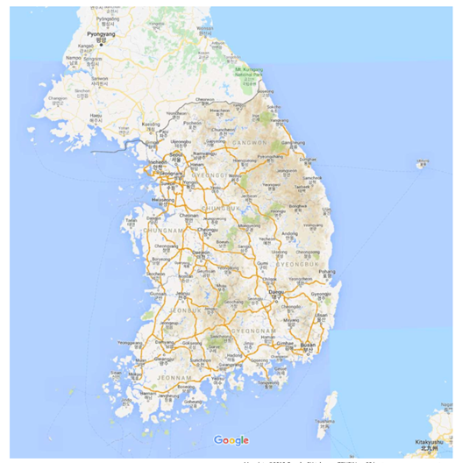
Aslla?
Old name of Gangneung!

Slide 3
Aslla Symposium
Funded by the Korean Government (the Ministry of Science and ICT)
Invitation only
Small (20-30 people)
Intimate
3-4 days
Mix of renowned and young, talented researchers
Great food and drinks
This time, about emerging topics in haptics!

Slide 4
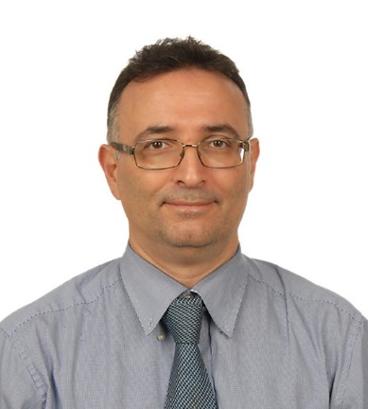
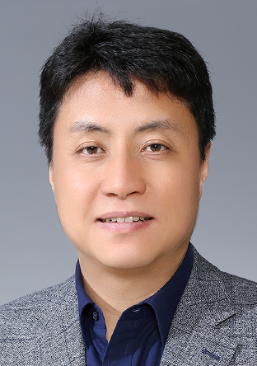
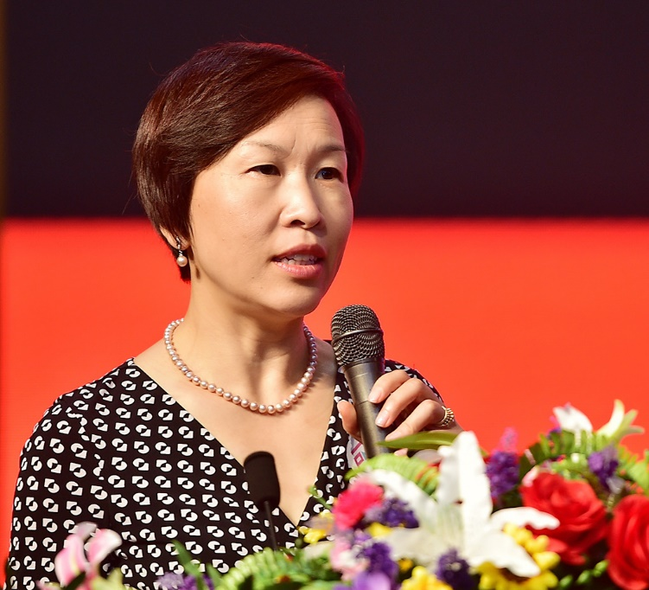
Co-Organizers
Hong Z. Tan
Cagatay Basdogan
Seungmoon Choi

Slide 5
Why Are You Invited?
Co-organizers met to decide new, cool, important topics in haptics at the moment.
For each topic, we assembled a group of world-famous best researchers.
So you were invited, and then you accepted to come!
+ Some young, fresh, talented Korea-residing PhDs

Slide 6
Scientific Program – Jan. 30
9 - 10 | Opening and Introduction of Attendees
10 - 12 | Session 1: Novel Haptic Stimulation Methods
10:00 - 10:20 | Cagatay Basdogan: Surface Haptics: Electrovibration
10:20 - 10:40 | Dong-Soo Kwon: Surface Haptic Actuators
10:40 - 11:00 | Hyung-Sik Kim: Mid-air Haptics Using Laser and Electromagnetics
11:00 - 12:00 | Panel Discussion
12:30 pm - 1:30 | Lunch
1:30 - 3:30 | Session 2: Design and Authoring of Haptic Content
1:30 - 1:50 | Karon MacLean: The Tools the Haptic Designers Need
1:50 - 2:10 | Abdulmotaleb El Saddik: Haptics-based Multimedia Environments
2:10 - 2:30 | Seungmoon Choi: Automatic Synthesis of Haptic Content
2:30 - 3:30 | Panel Discussion
3:30 - 4:00 | Coffee Break

Slide 7
Scientific Program – Jan. 30 (cont.)
4 - 6 | Session 3: Haptics for VR and HCI
4 - 4:20 | Bum-Jae You: Wearable Human Interfaces for Coexistent Reality
4:20 - 4:40 | Gerard Jounghyun Kim: Multi-modal Fusion: In Search of the Usable Physicality
4:40 - 5 | Ian Oakley: Haptics and HCI: Synergies and Divergencies
5 - 6 | Panel Discussion
6:30 - 7:30 | Dinner (On site)
8 - 10 | Poster Session with Drinks: Young Talents
 | Inwook Hwang, Gunhyuk Park, Yongjae Yoo, Hojin Lee
 | Dongbum Pyo, Amit Bhardwaj, Hong Z. Tan (with demo)

Slide 8
Scientific Program – Jan. 31
9 - 10 | Session 4: Rising Stars
9:00 - 9:20 | Mohamad Eid: The Rise of Haptics: Science, Interfaces and Applications
9:20 - 9:40 | Seokhee Jeon: Creating Better Feedback with Ease: Data-Driven Haptics and Haptic Augmentation
9:40 - 9:00 | Vincent Levesque: Haptics+UX: Enriching User Experiences with Haptics
10 - 11 | Special Session: Where and How to Publish Haptics Articles?
 | Cagatay Basdogan, Hong Z. Tan
11 - 11:30 | Coffee Break
11:30 - 12:30 pm | Session 5: Haptics and Robotics - What is Going On
11:00 - 11:20 | Jee-Hwan Ryu: New Horizon of Telerobotics from Stability to Performance
11:20 - 11:40 | Dongjun Lee: From Robotics to Haptics, from Haptics to Robotics
11:40 - 12:00 | Panel Discussion
12:30 - 1:30 pm | Lunch

Slide 9
Scientific Program – Jan. 31 (cont.)
1:30 - 3:30 | Session 6: Haptics in Industry
1:30 - 1:50 | Hong Z. Tan: Collaboration between Academic and Industry
1:50 - 2:10 | Ki-Duk Kim: Haptic Direction and Intensity for Virtual Buttons on Automotive Displays
2:10 - 2:30 | Dong Chul Park: Vehicle Sound Design and Haptics
2:30 - 3:30 | Panel Discussion
3:30 - 4:00 | Coffee Break
4 - 6 | Session 7: Flexible Haptic Interfaces
4:00 - 4:20 | Ki-Uk Kyung: Is SOFT actuator HARD enough to be haptic interface?
4:20 - 4:40 | Van Ho: Morphological Design in Soft Haptic Sensing Interfaces
4:40 - 5:00 | Sang-Youn Kim: Design of Soft haptic Actuator Based on Plasticized PVC
5:00 - 6:00 | Panel Discussion
6:30 - 10 | Dinner (Off-site) with Excursion

Slide 10
Scientific Sessions
Talks by experts on the session’s theme
Talks are videotaped
Upon speakers’ agreement, videos will be uploaded to YouTube
Panel discussion
Speakers will be moderators
Audience can write questions and discussion topics on papers and give them to moderators
One of the moderators will write minutes
We hope to get
Intense discussion on where to go from here
New research topics and ideas
Potential collaboration opportunities

Slide 11
After the Symposium
“News from the field” in ToH
YouTube channel with videos of your talks
Minutes of panel discussion
Asking you to write review papers about the session topics
Organizing a special issue (section) of review papers in ToH

Slide 12
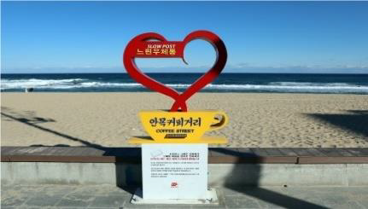
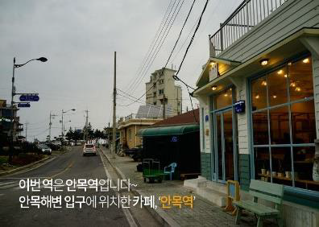
Excursion on Jan. 31
Traditional Korean formal dinner
Walk around Anmok Beach
A hip place in Gangneung with many coffee-related stores
Free time!

Slide 13
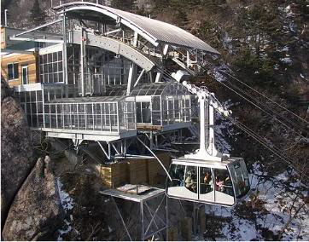
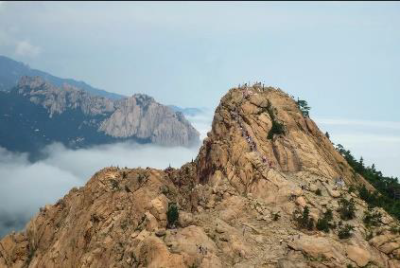
Excursion on Feb. 1
Seoraksan National Park
One of the best mountains in Korea
Cable car!
Elegant lunch

